Slide 1
Lecture 11.2 Relative Performance Evaluation

Slide 2
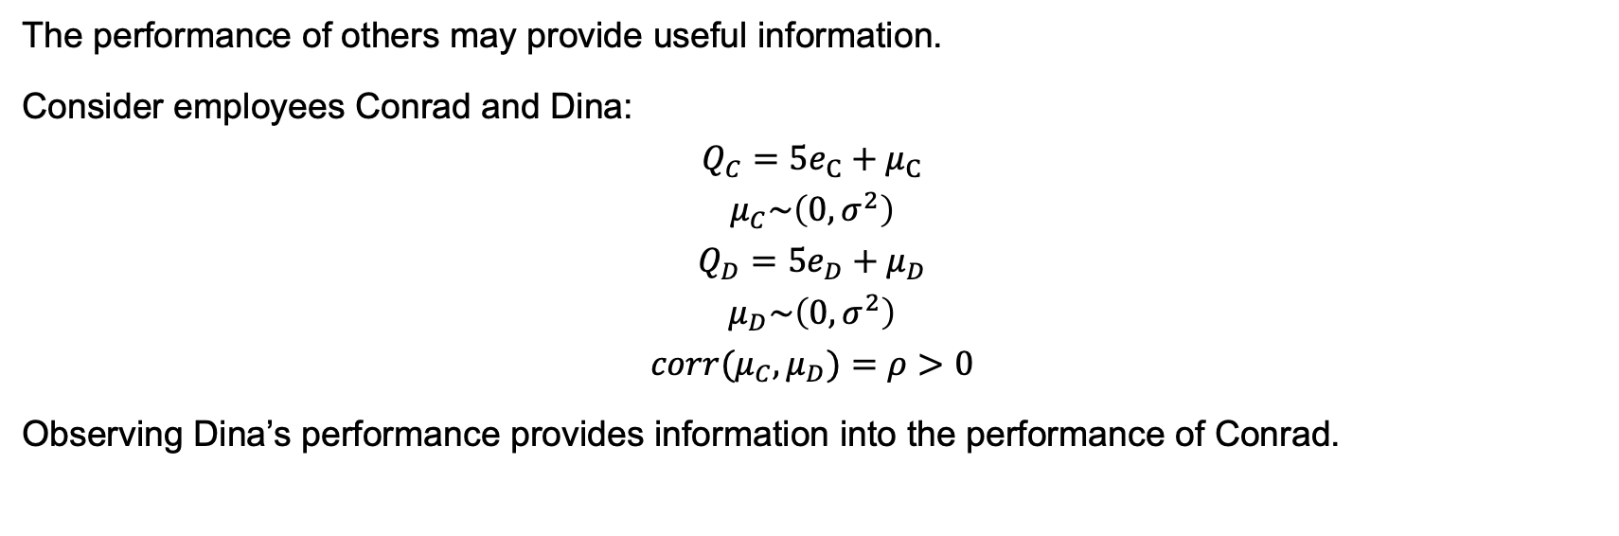
Relative Performance Evaluation
The performance of others may provide useful information.
Consider employees Conrad and Dina:
$$Q_{C}=5e_{C}+μ_{C}$$
$$μ_{C}\sim \left(0,σ^{2}\right)$$
$$Q_{D}=5e_{D}+μ_{D}$$
$$μ_{D}\sim \left(0,σ^{2}\right)$$
$$corr(μ_{C},μ_{D})=ρ>0$$
Observing Dina’s performance provides information into the performance of Conrad.

Slide 3
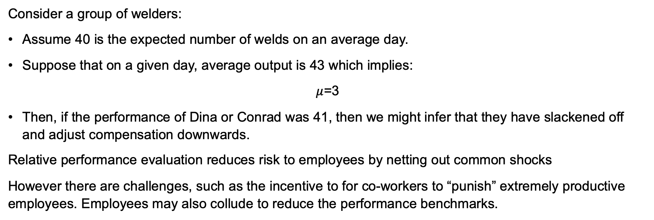
Relative Performance Evaluation
Consider a group of welders:
Assume 40 is the expected number of welds on an average day.
Suppose that on a given day, average output is 43 which implies:
$μ$=3
Then, if the performance of Dina or Conrad was 41, then we might infer that they have slackened off and adjust compensation downwards.
Relative performance evaluation reduces risk to employees by netting out common shocks
However there are challenges, such as the incentive to for co-workers to “punish” extremely productive employees. Employees may also collude to reduce the performance benchmarks.

Slide 4
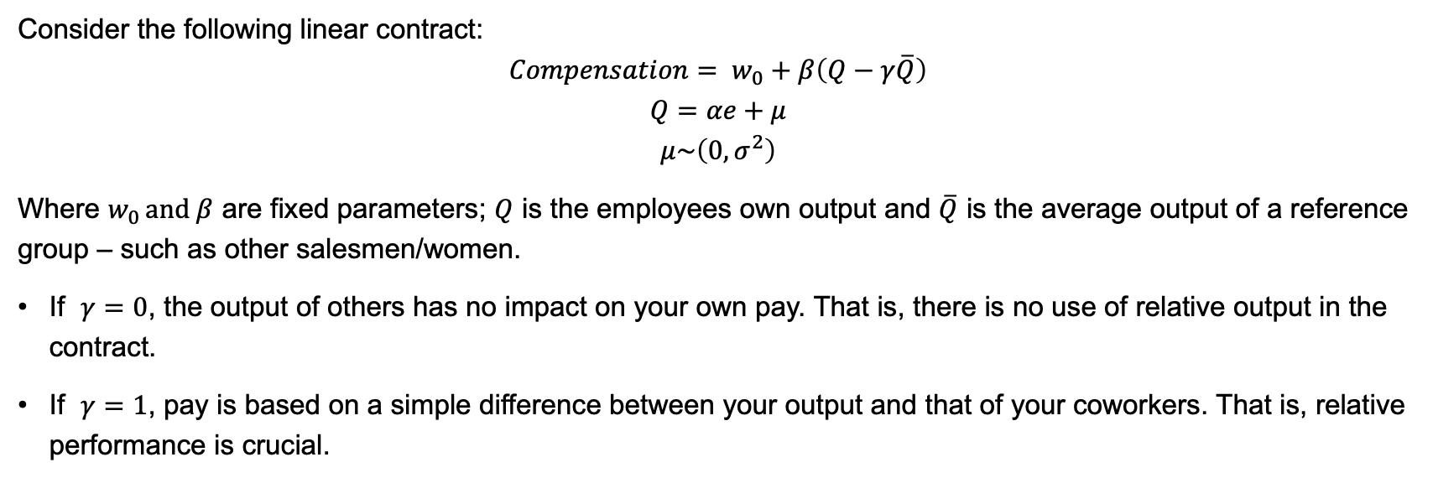
Relative Performance Contract
Consider the following linear contract:
$$Compensation= w_{0}+β\left(Q−γ\overline{Q}\right)$$
$$Q=αe+μ$$
$$μ\sim \left(0,σ^{2}\right)$$
Where $w_{0 }and β$ are fixed parameters; $Q$ is the employees own output and $\overline{Q}$ is the average output of a reference group – such as other salesmen/women.
If $γ=0$, the output of others has no impact on your own pay. That is, there is no use of relative output in the contract.
If $γ=1$, pay is based on a simple difference between your output and that of your coworkers. That is, relative performance is crucial.

Slide 5
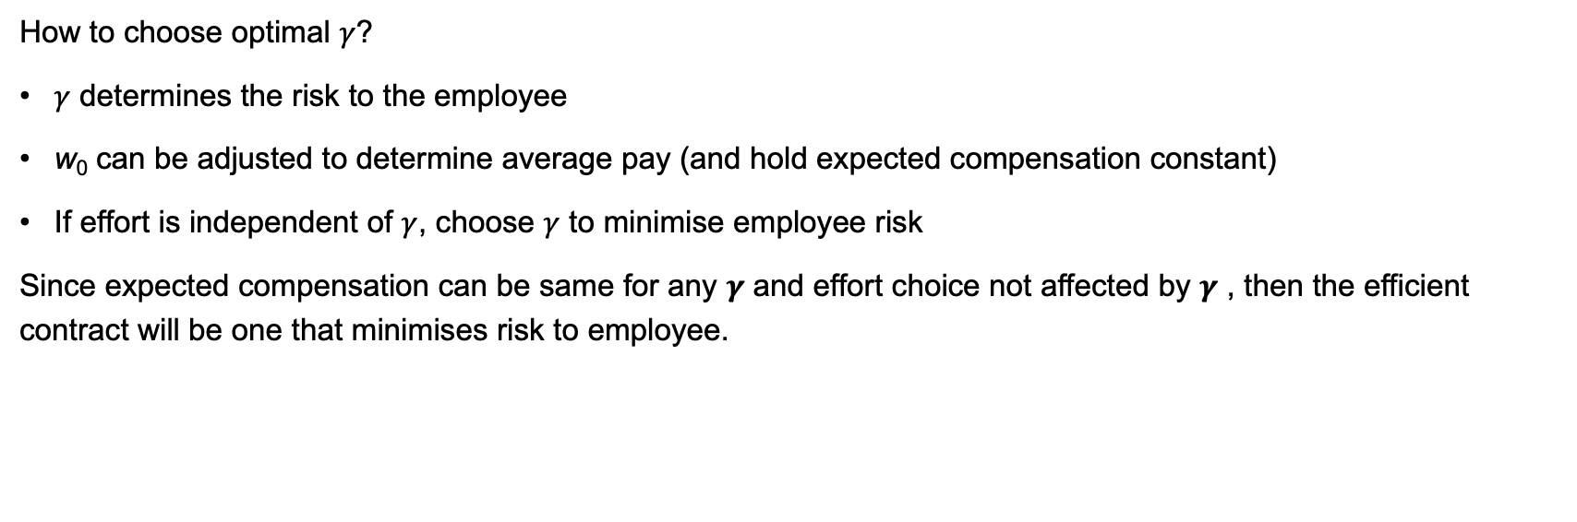
Relative Performance Contract
How to choose optimal $γ$?
$γ$ determines the risk to the employee
w₀ can be adjusted to determine average pay (and hold expected compensation constant)
If effort is independent of $γ$, choose $γ$ to minimise employee risk
Since expected compensation can be same for any $γ$ and effort choice not affected by $γ$ , then the efficient contract will be one that minimises risk to employee.

Slide 6
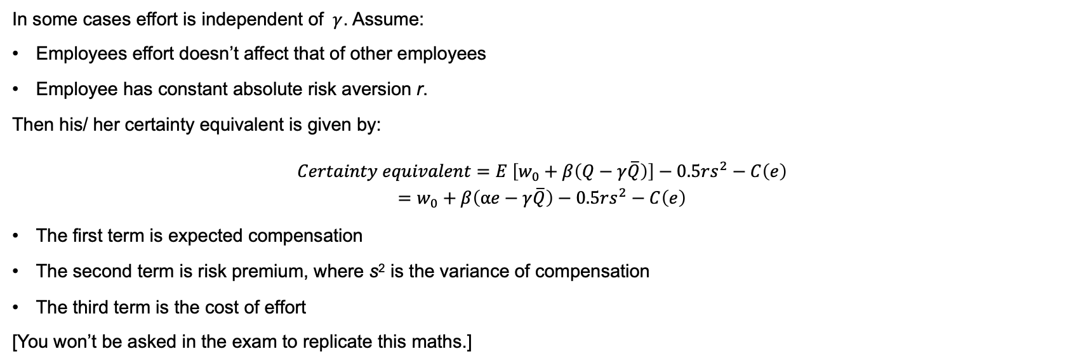
Relative Performance Contract
In some cases effort is independent of $γ$. Assume:
Employees effort doesn’t affect that of other employees
Employee has constant absolute risk aversion r.
Then his/ her certainty equivalent is given by:
$$Certainty equivalent=E \left[w_{0}+β\left(Q−γ\overline{Q}\right)\right]−0.5rs^{2}−C\left(e\right)$$
$$=w_{0}+β\left(αe−γ\overline{Q}\right)−0.5rs^{2}−C\left(e\right)$$
The first term is expected compensation
The second term is risk premium, where s² is the variance of compensation
The third term is the cost of effort
[You won’t be asked in the exam to replicate this maths.]

Slide 7
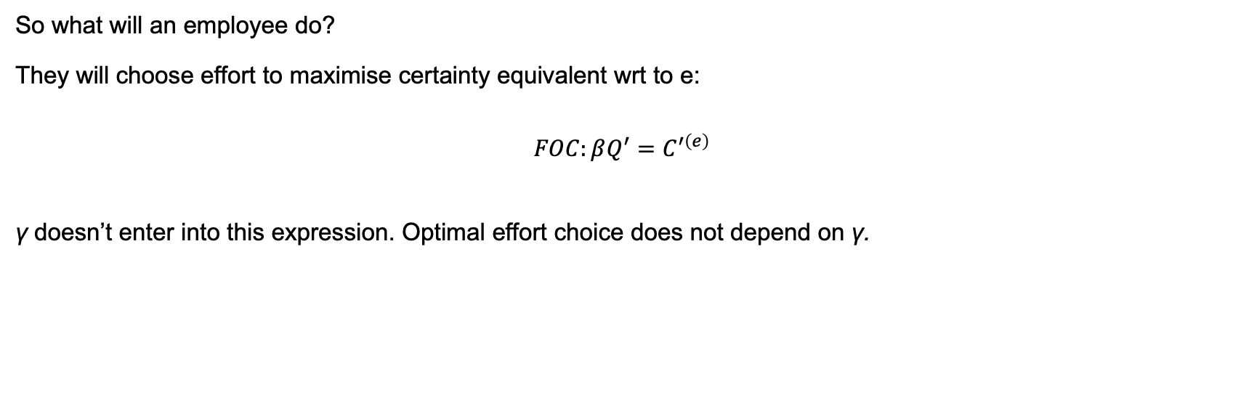
Relative Performance Contract
So what will an employee do?
They will choose effort to maximise certainty equivalent wrt to e:
$$FOC:βQ^{′}=C^{′\left(e\right)}$$
γ doesn’t enter into this expression. Optimal effort choice does not depend on γ.

Slide 8
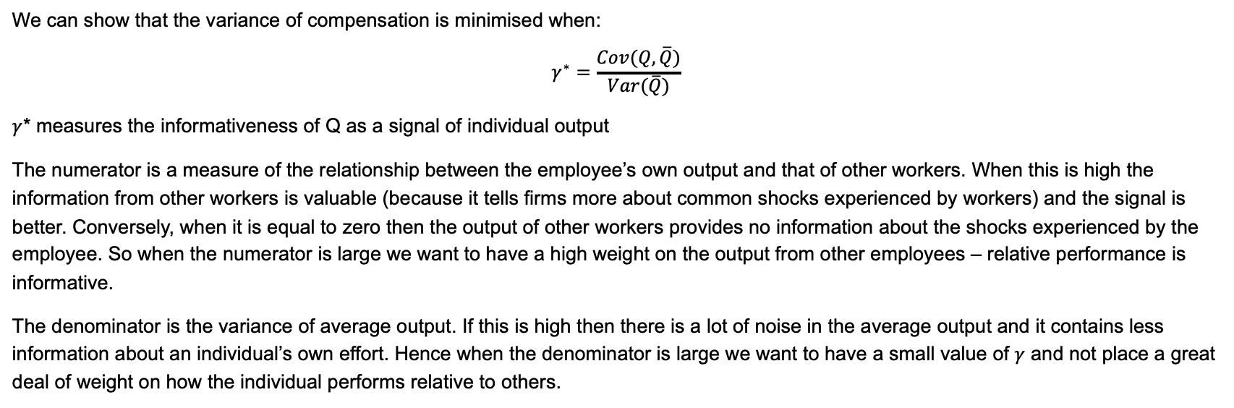
Relative Performance Contract
We can show that the variance of compensation is minimised when:
$$γ^{∗}=\frac{Cov(Q,\overline{Q})}{Var(\overline{Q})}$$
$γ$* measures the informativeness of Q as a signal of individual output
The numerator is a measure of the relationship between the employee’s own output and that of other workers. When this is high the information from other workers is valuable (because it tells firms more about common shocks experienced by workers) and the signal is better. Conversely, when it is equal to zero then the output of other workers provides no information about the shocks experienced by the employee. So when the numerator is large we want to have a high weight on the output from other employees – relative performance is informative.
The denominator is the variance of average output. If this is high then there is a lot of noise in the average output and it contains less information about an individual’s own effort. Hence when the denominator is large we want to have a small value of $γ$ and not place a great deal of weight on how the individual performs relative to others.

